Slide 1
MAKING THE MOST OF YOUR MONEY
OLATUNJI O AKINOLA
In This Segment
Your benefits and entitlements
Making the most of your income
Alternative sources of income

Slide 2
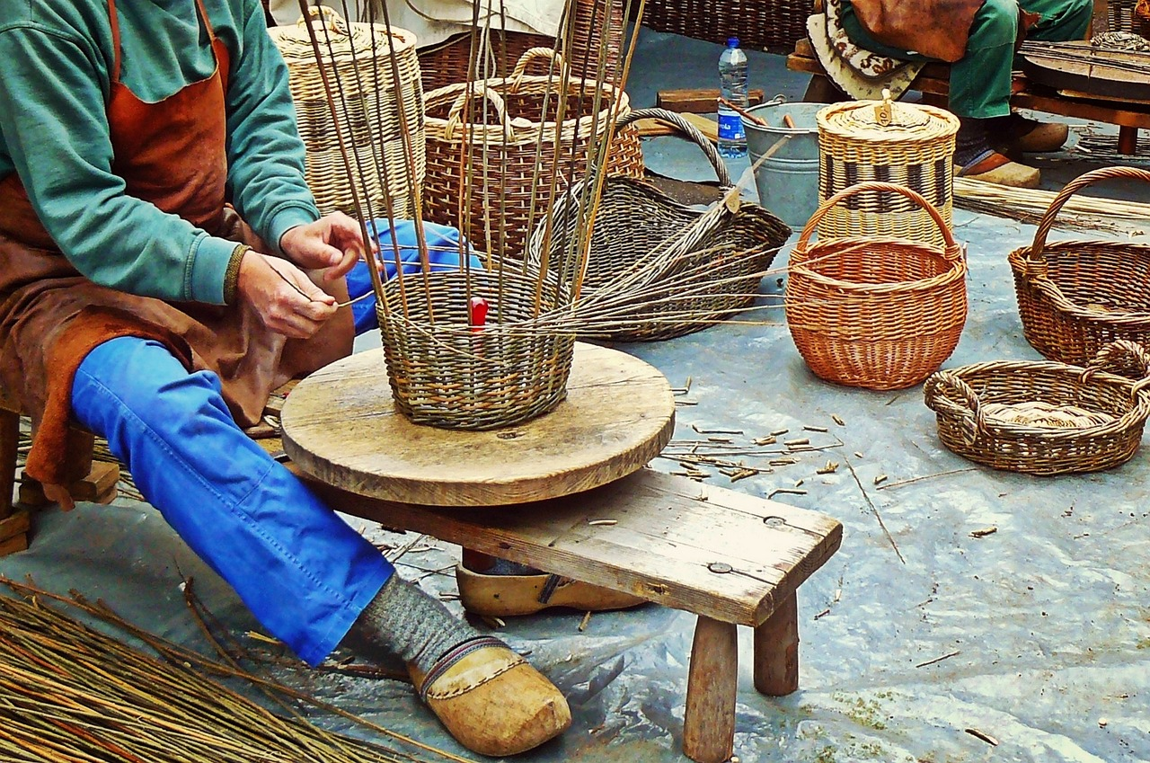
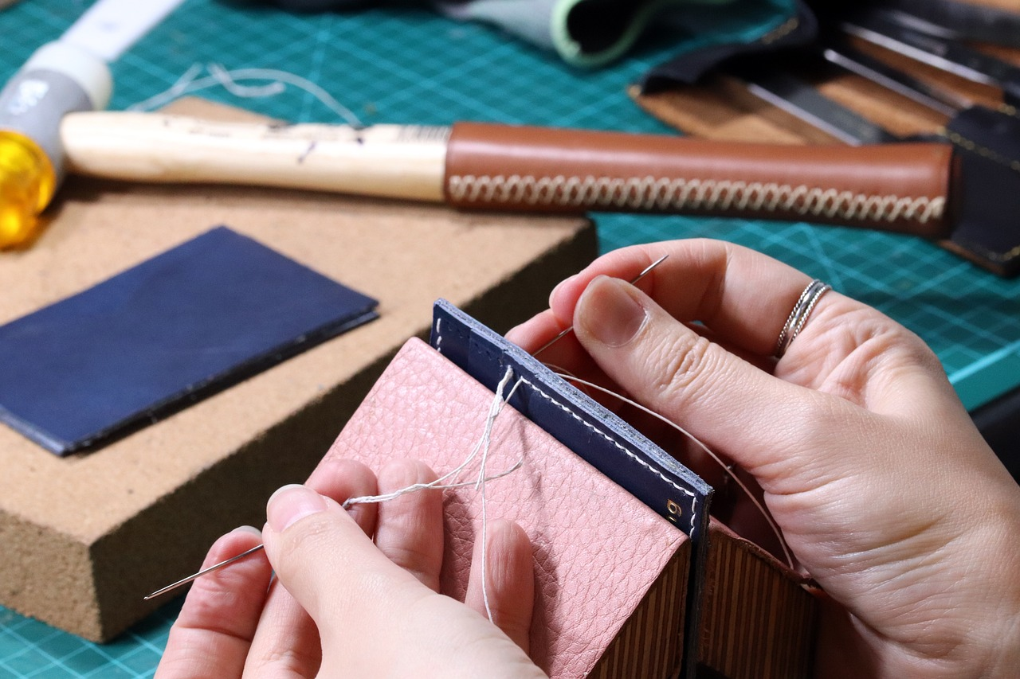
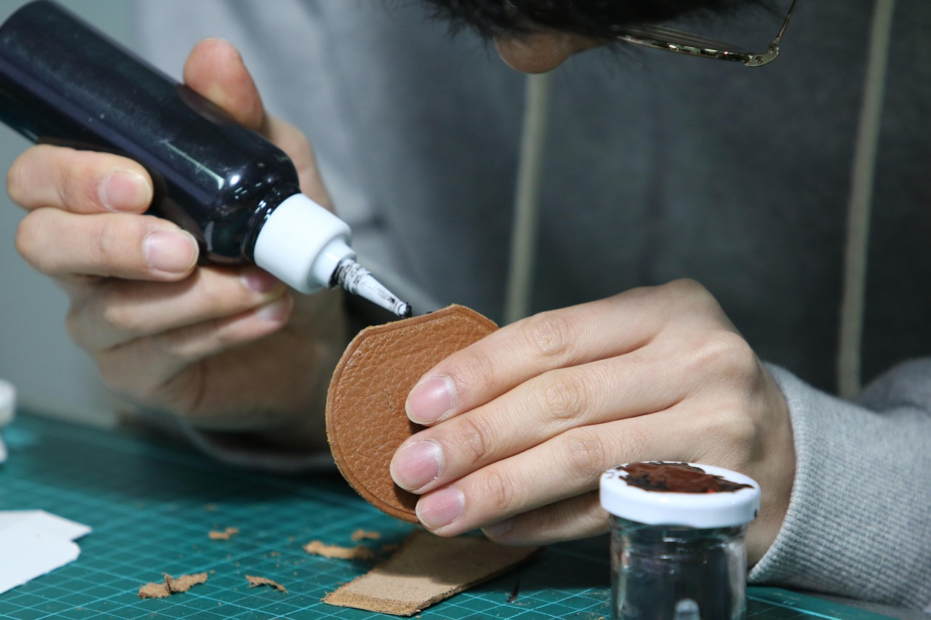
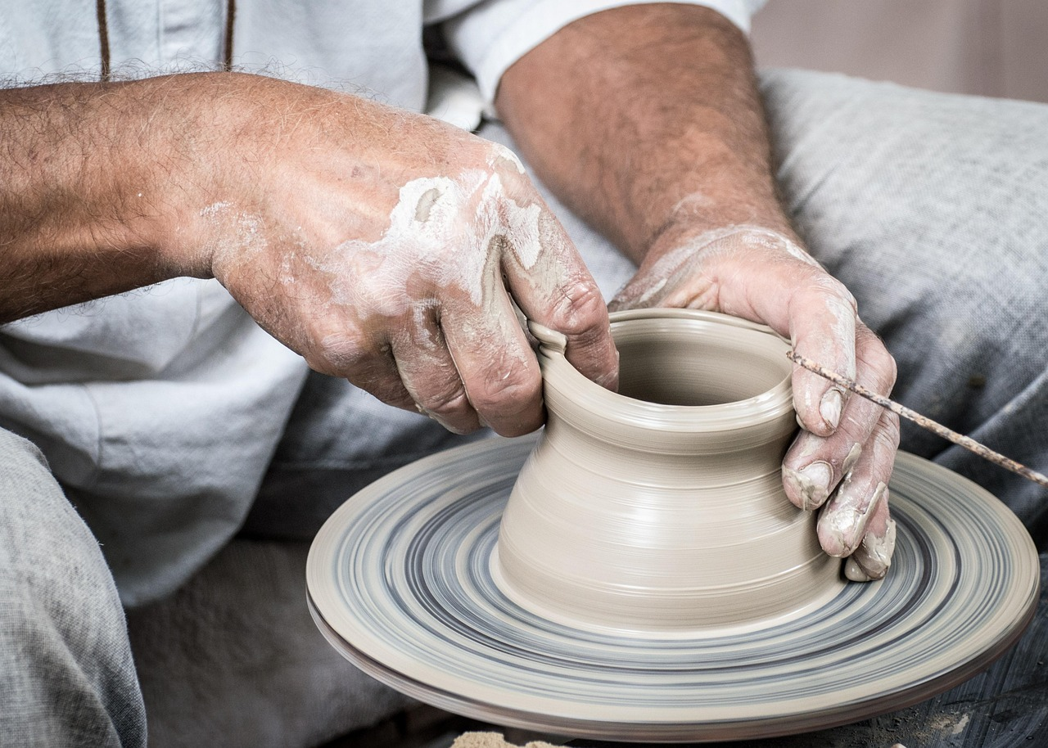
This Session
Your benefits and entitlements
Making the most of your income
Alternative sources of income
C
R
A
F
T

Slide 3
C
R
A
F
T
Notes:
What can you see?
What’s common in all these crafts? – All use their hands; All have to look carefully; Meticulousness. Needs time and dedication.

Slide 4
C
ontentment
“But godliness with contentment is great gain”. 1 Timothy 6:6.
Contentment is a state of peace and joy that comes from
trusting in God and accepting what he has provided.
Notes:
Contentment requires courage and discipline.

Slide 5
C
ontentment
“Keep your life free from love of money, and be content with what you have”. Hebrews 13:5
Contentment requires courage and discipline.
Live within your capacity
Be disciplined with saving
Don’t be in a haste to get things
Curtail your wild desires
Notes:
Contentment requires courage and discipline.

Slide 6
R
esourceful
“They can make an inexperienced person clever and teach young people how to be resourceful”. Proverbs 1:4 (GNT).
Resourcefulness is the “ability to act effectively or imaginatively,
especially in difficult situations; be able to deal skilfully and
promptly with new and difficult situations, difficulties; and be able to find solutions to problems.”
Notes:
What can you see?
What’s common in all these crafts? – All use their hands; All have to look carefully; Meticulousness. Needs time and dedication.

Slide 7
R
esourceful
“Precious treasure and oil are in a wise man's dwelling, but a foolish man devours it” Proverbs 21:20.
Shop Around
If you can get it for free, don’t pay for it
Use your accounts and credit cards to your advantage
Notes:
What can you see?
What’s common in all these crafts? – All use their hands; All have to look carefully; Meticulousness. Needs time and dedication.

Slide 8
A
cknowledge
“That the sharing of your faith may become effective by the acknowledgement of every good thing which is in you in Christ Jesus”. Philemon 1:6
To acknowledge is to accept, admit, or recognize something, or the truth or existence of something. It also means to have full knowledge of and be aware of something.
Notes:
What can you see?
What’s common in all these crafts? – All use their hands; All have to look carefully; Meticulousness. Needs time and dedication.

Slide 9
A
cknowledge
“That the sharing of your faith may become effective by the acknowledgement of every good thing which is in you in Christ Jesus”. Philemon 1:6
Admit your strengths and weaknesses
Utilise what’s available to you
Your personal savings allowance - PSA
Take advantage of your Individual Savings Account – e.g. Cash ISAs
Utilise account benefits to your advantage
Claim tax relief on your charitable giving
Notes:
What can you see?
What’s common in all these crafts? – All use their hands; All have to look carefully; Meticulousness. Needs time and dedication.

Slide 10
A
cknowledge
“Plant your seed in the morning and keep busy all afternoon, for you don’t know if profit will come from one activity or another—or maybe both” Ecclesiastes 11:6
Explore other sources of income
Stocks and shares
Property Investments
Have a business on the side
Monetise your skills and talents
Crypto currencies and AI investments
Notes:
What can you see?
What’s common in all these crafts? – All use their hands; All have to look carefully; Meticulousness. Needs time and dedication.

Slide 11
F
aithfulness
“Now it is required that those who have been given trust must prove faithful” 1 Corinthians 4:2
To be faithful means to be firm in adherence to promises or in observance of duty: conscientious a faithful employee
Notes:
What can you see?
What’s common in all these crafts? – All use their hands; All have to look carefully; Meticulousness. Needs time and dedication.

Slide 12
F
aithfulness
“Now it is required that those who have been given trust must prove faithful” 1 Corinthians 4:2
Take stock of what you have
You must have a budget
Monitor your spending, keep records
Have different cash pots, accounts
Notes:
What can you see?
What’s common in all these crafts? – All use their hands; All have to look carefully; Meticulousness. Needs time and dedication.

Slide 13
T
hankfulness
“In every situation [no matter what the circumstances] be thankful and continually give thanks to God; for this is the will of God for you in Christ Jesus” 1 Thessalonians 5:18
Thankfulness is the feeling of being happy or grateful because of something
Notes:
What can you see?
What’s common in all these crafts? – All use their hands; All have to look carefully; Meticulousness. Needs time and dedication.

Slide 14
T
hankfulness
“In every situation [no matter what the circumstances] be thankful and continually give thanks to God; for this is the will of God for you in Christ Jesus” 1 Thessalonians 5:18
Always be courteous and kind
Have a pleasant attitude
Be liberal and give
Reward yourself
Notes:
What can you see?
What’s common in all these crafts? – All use their hands; All have to look carefully; Meticulousness. Needs time and dedication.

Slide 15
THANK YOU FOR LISTENING
Q&A
OLATUNJI O AKINOLA
In This Segment
Your benefits and entitlements
Making the most of your income
Alternative sources of income

